Slide 1
SWITCHED MODE RECTIFIER

Slide 2
An induction motor load is connected to a dc source through an inverter. Rectifier mode of operation occurs
during regenerative braking.
Kinetic energy associated with motor and load is recovered and fed back to the dc source.

Slide 3
A single phase induction motor is connected to dc source through a converter.
L_{s} is winding inductance
V_{s} is Back emf
sinusoidal with fundamental frequency

Slide 4
Converter output voltage
V_{con} = V_{Ls} + V_{s}
V_{Ls} = L_{s} di_{s}/dt
Fundamental component of V_{con}
V_{con1} = V_{Ls1} + V_{s}
V_{s} = V_{con1} – V_{Ls1}
= V_{con1} – jωL_{s}I_{s1}
Direction of i_{s1} decides the inverter and rectifier modes of operation.

Slide 5
Inversion Mode
V_{con1} leads v_{s} by an angle δ
Real power at the ac side is
P = v_{s}I_{s1} cosθ
V_{Ls1}
V_{con1}
V_{Ls1}
θ
δ
V_{s}
θ
I_{s1}
V_{con1} leads v_{s} and active component of I_{s1} is in phase with v_{s}.
Power flows from dc side to ac side - inversion mode

Slide 6
Reactive power at the ac side
Q = v_{s}I_{s1} sinθ
V_{con1}
V_{Ls1}
θ
δ
θ
V_{s}
I_{s1}

Slide 7
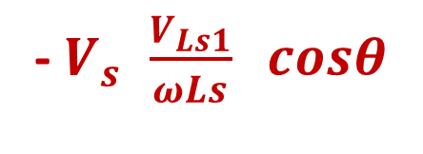
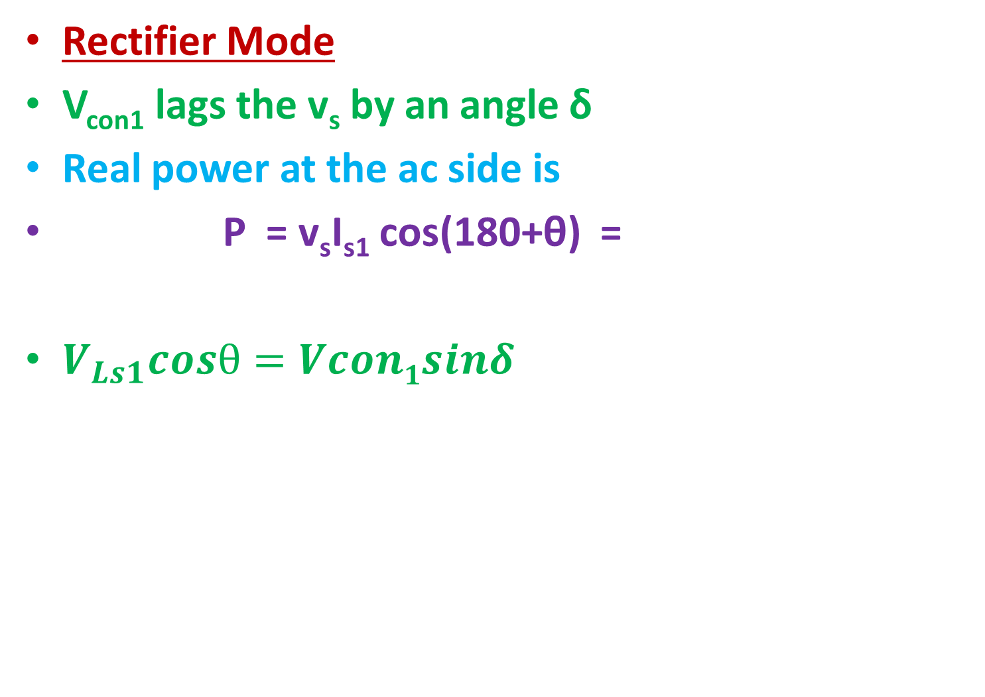
Rectifier Mode
V_{con1} lags the v_{s} by an angle δ
Real power at the ac side is
P = v_{s}I_{s1} cos(180+θ) =
$V_{Ls1}cosθ=Vcon1sinδ$
- $V_{s }\frac{V_{Ls1}}{ωLs} cosθ$
I_{s1}
θ
V_{s}
δ
90-θ
V_{Ls1}
90+θ
V_{Ls1}
V_{con1}

Slide 8
Reactive power at the ac side
Q = v_{s}I_{s1} sin(180+θ)
Q is the sum of reactive power absorbed by the converter and the inductance L_{s}.
At very high switching frequencies L_{s} can be made very small.
I_{s1}
θ
V_{s}
V_{s}
δ
V_{Ls1}
90+θ
V_{Ls1}
V_{con1}
Then Q is the reactive power absorbed by the converter.

Slide 9
For a given value of ac side potential (back emf) v_{s} and the chosen value of inductance L_{s},
desired values of P & Q can be obtained
by controlling the
magnitude and phase angle δ of v_{con1}.

Slide 10
V_{con1} can be varied by keeping the magnitude of I_{s1} and v_{s} constant.
V_{Ls1}
V_{con1}
δ
V_{Ls1}
θ
V_{s}
I_{s1}

Slide 11
V_{con1} can be varied by keeping the magnitude of I_{s1} and v_{s} constant.
Inversion at upf
Rectification at upf
In both cases
V_{Ls1}
V_{con1}
δ
V_{Ls1}
I_{s1}
V_{s}
I_{s1}
V_{s}
δ
V_{Ls1}
V_{con1}
V_{Ls1}

Slide 12
For the desirable magnitude and direction of P & Q, the magnitude of v_{con1} and the phase angle δ must be controlled.
PWM converter works in the linear range (m_{a}≤1)
V_{d} must be of sufficiently large magnitude.
V_{d} > √2 V_{s}

Slide 13
Reactive power flow can be controlled by introducing a phase shift between i_{s} and v_{s}
PWM VSI based STATIC VAr COMPENSATION
PWM VSI based SVCs are viable solution to problems associated with passive shunt compensators Thyristor controlled reactors.
They are capable of delivering controlled amount of lagging and leading Vars to a load or a bus system rapidly.

